Slide 1

VSP Discovery and Logistics Workshop
VA.gov | By Light
VSP Product Development Support Team
#vfs-platform-support
July 30, 2019

Slide 2
Welcome!

Slide 3
What questions do you have?

Slide 4
Agenda
VSP ONBOARDING
Demo: Slack and Zenhub walkthroughs
Demo: Ticket creation in Zenhub
Demo: Pull request creation in Github
Discovery & Logistics
Questions

Slide 5
Slack walkthrough

Slide 6
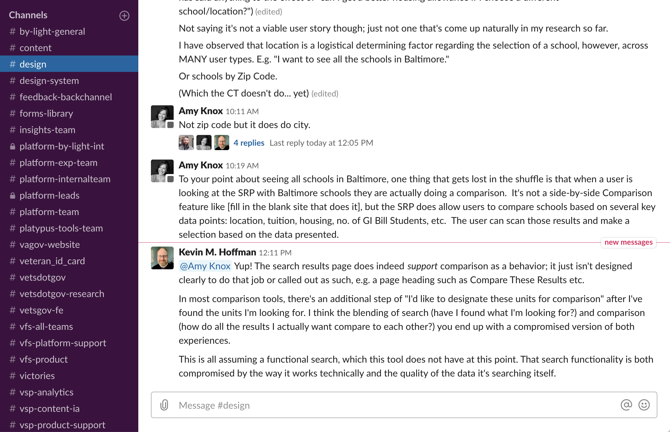
Slack
COMMUNICATION
@-messaging in Slack
Use public channels for questions and discussion

Slide 7
Zenhub walkthrough

Slide 8
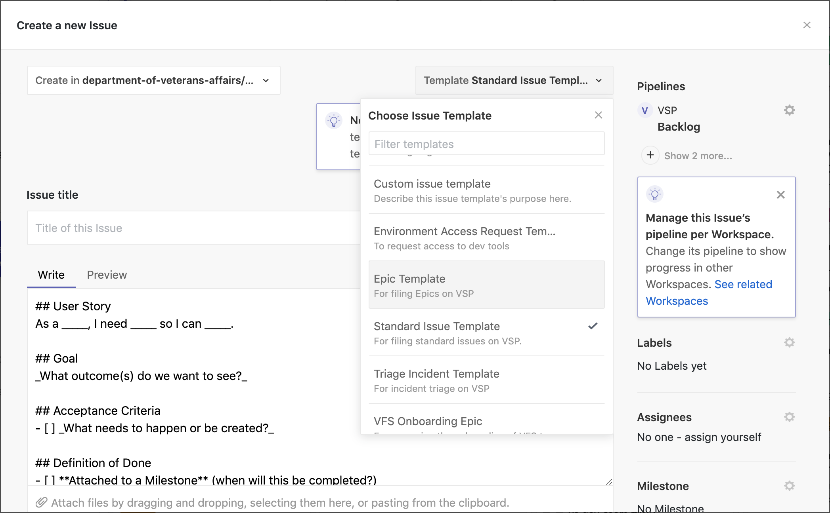
Zenhub
COMMUNICATION
Create an epic
Create an issue and associate it with the epic
Create a “By Light” and “notifications-settings” label
Add the “Dragons” team label
Create another issue and demonstrate the blocker feature
Create a 508 ticket
Notes:
Trevor

Slide 9
Pull Request Creation

Slide 10
Pull Requests
COMMUNICATION
Discuss the pull request cadence:
Frequency
Size of code change
When to break a PR into smaller atomic changes
Show the PR template
Show how to associate the pull request with a Zenhub issue
Show how to use the draft PR feature
Show how to mark the PR ready for review
Show how to ask a reviewer for a second look (re-request)
Notes:
Bill

Slide 11
Discovery

Slide 12
Product Scope
DISCOVERY
Is this a new product, or an improvement of an existing one?
New product; SMS notifications
What are the goals or desired outcomes for this product?
ZenHub Ticket: The team needs clarity on product requirements and scope
Who is the product owner? Clarice? Lisa?
Do you have any key performance metrics (KPMs) and if so, what are they?
Need more clarity
Google Analytics tags needed? Tag Nedie

Slide 13
Product Requirements
DISCOVERY
Is there a requirements document or engineering specification?
Request this info. We have the mockup.
Does this product have any soft deadlines?
Does this product have any hard deadlines?
We need information about deadlines.
Does this product have any Congressional mandates?
Need to find out
Are there any promotional or marketing efforts planned?
No plans for this iteration. Confirm this.
Do we need a user journey map? What about error messages, edge cases, etc.?

Slide 14
Work cadence
DISCOVERY
When are your standups?
TBD: Twice a week; possibly Monday afternoons
Can you invite Bill to one standup per week?
Yes

Slide 15
Work In Progress
DISCOVERY
Are there any work items in progress?
This could include content strategy, information architecture, visual designs, or front/back-end code.
Only design mock-ups

Slide 16
Content Strategy
DISCOVERY
Have you talked to Peggy Gannon, Content Strategist?
When does your team plan to schedule a content review?
To be scheduled
Find out if Peggy has reviewed the mockup

Slide 17
Information Architecture
DISCOVERY
Have you talked to Mikki Northuis, Information Architect?
When does your team plan to schedule an IA review?
To be scheduled
Find out if Mikki has approved and reviewed IA in mockup

Slide 18
User Research
DISCOVERY
When does your team plan to conduct user research?
Find out if this work has been usability tested with Veterans

Slide 19
Design and UX
DISCOVERY
When does your team plan to schedule a UX review?

Slide 20
Front End Development
DISCOVERY
Has your team previously used the Formation design system?
Bill to review this in FE session
How do you approach testing? Does your team prefer to write unit, e2e, or integration tests?
Bill to review in FE session; team will review docs
Does your team include tests as part of code submissions?
Yes
What’s your comfort level with React and Redux?
Intro; becoming comfortable
Are you familiar with Liquid templates?
Intro; becoming comfortable

Slide 21
Back End Development
DISCOVERY
Does your team know of any integration points like a login routine that will be needed for your product?
We think they’ve already been created
Find out if saving a notification preference to VetsAPI exists
Vets360 API
Are there any APIs needed to make your product function correctly?
Find out how to test with the API
Who can we talk to about this?
How can we test locally?

Slide 22
Accessibility
DISCOVERY
Are you planning to integrate with any third-party libraries or UI components like drag-and-drop or mapping interfaces?
No
Does your QA effort include any accessibility testing?
No, but it will include linting
Coordinate 508 audit with Trevor when ready
Can you describe the test procedures used?
Would you be interested in additional accessibility best practice training sessions?
Can you describe the type of training that would be most useful?

Slide 23
Fun Retro!
https://funretro.io/publicboard/GA6FytXshefGZuv9QrKzEfku0Qa2/7cebb5ea-9807-4aba-90b4-ef8ce0e4cb33
Notes:
Layla

Slide 24
Final thoughts
VSP ONBOARDING
What questions do you have?
Are you interested in more detailed walk-throughs; yes:
frontend
backend
508 and testing
How was your onboarding experience?
Provide a roadmap for onboarding
Expectations for timing and duration
Reiterate culture of Slack, Zoom, etc.
Notes:
Layla

Slide 25
Thank you!

